Slide 1

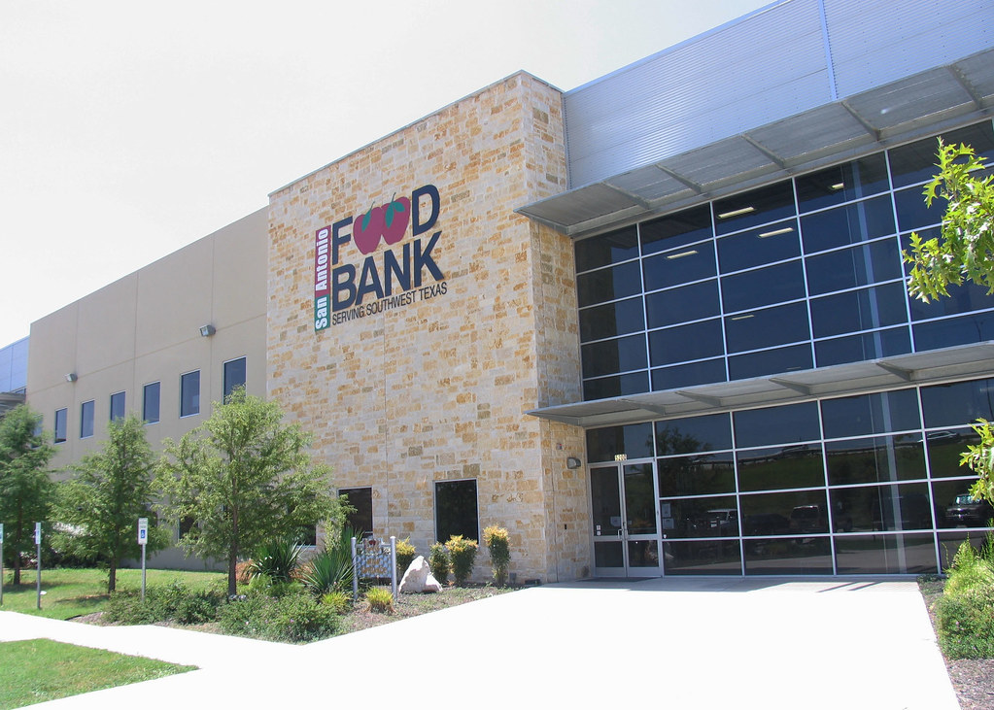
Pantry pal
Problem Statement: Designing a platform that connects people with surplus foods with local food banks and helps reduce food wastage.
Definition: It easily connects people or organizations who have surplus food such as grocers, retailers, restaurants, farmers, suppliers, food distribution companies, and more to food banks and other NGOs etc. For further distribution
This Photo by Unknown Author is licensed under CC BY-ND

Slide 2

Pantry Pal
Surplus food listings: The website can list surplus food available for donation. This can be done by partnering with farmers and food businesses to donate excess food to nonprofits or directly to the needy
Food bank locator: The website can include a food bank locator that allows users to search for food banks in their area. This can be done by integrating with existing databases of food banks.
Donation tracker: The website can include a donation tracker that allows users to track their donations to food banks. This can help users keep track of their donations and see the impact they are making.
Volunteer opportunities: The website can include information about volunteer opportunities at local food banks. This can help users get involved in their community and support local hunger relief efforts

Slide 3

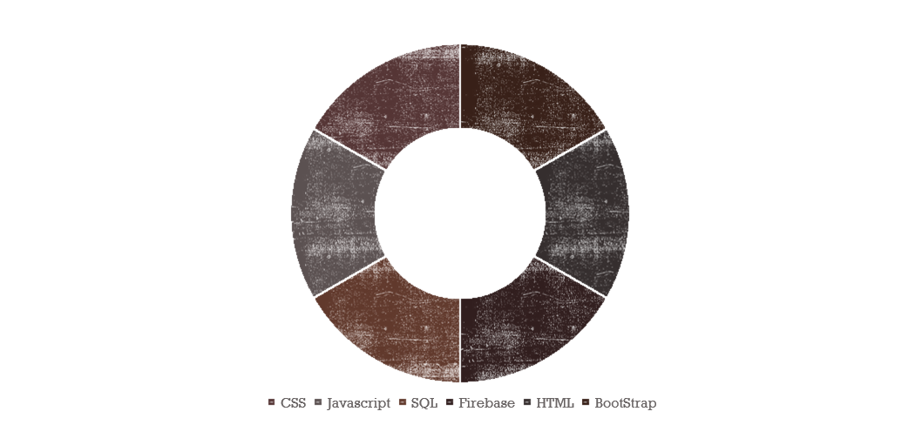
Techstack

Slide 4

Our Trailblazing Viewpoint
Connecting food donors with food banks: The website can connect food donors with food banks and other organizations that can distribute surplus food to people in need. This can help reduce food waste by ensuring that excess food is used to feed people instead of being thrown away.
Raising awareness about food waste: The website can provide information about the impact of food waste on the environment and society. This can help raise awareness about the issue and encourage people to take action to reduce food waste.
Providing resources for reducing food waste: The website can provide tips and resources for reducing food waste, such as meal planning, proper food storage, and composting. This can help individuals and businesses reduce their food waste and save money.
Supporting local communities: By connecting food donors with local food banks and other organizations, the website can support local communities and help reduce food insecurity. This can help ensure that everyone has access to healthy and nutritious food.
Encouraging sustainable food practices: The website can promote sustainable food practices, such as reducing food waste, using locally sourced ingredients, and supporting small-scale farmers. This can help promote a more sustainable food system and reduce the environmental impact of food production and consumption.
Overall, creating a website for surplus food can help reduce food waste, support local communities, and promote sustainable food practices. By connecting food donors with food banks and providing resources for reducing food waste, the website can help ensure that excess food is used to feed people instead of being thrown away

Slide 5
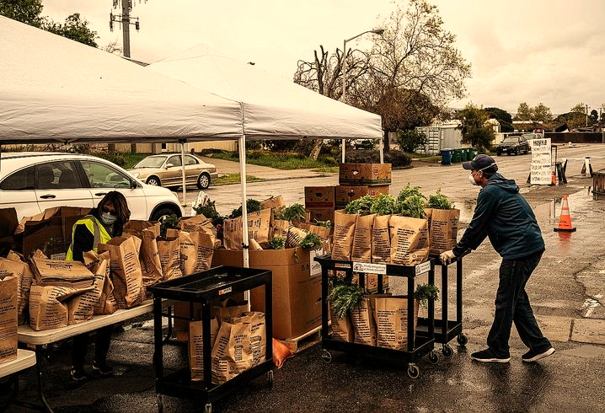
Architecture of idea
Front-end development: The website can be developed using front-end development tools such as HTML, CSS, and JavaScript. Bootstrap, a free and open-source CSS framework directed at responsive front-end web development, can be used to create responsive and mobile-friendly web pages
Back-end development: The website can be developed using back-end development tools such as firebase, SQL. The backend can be used to manage the database, handle user authentication, and process user requests.
Database management: The website can use a database management system such as MySQL or MongoDB to store information about food donors, food banks, and surplus food listings.
User interface: The website can have a user-friendly interface that allows users to search for surplus food listings, donate food, and connect with local food banks. The user interface can be designed using Bootstrap or other front-end development tools.
Integration with other systems: The website can be integrated with other systems such as Ai APIs, digital agricultural extension services, and food waste reduction resources to provide users with more information and resources
Security: By incorporating these components, a website for surplus food can be designed to connect food donors with food banks, raise awareness about food waste, and provide resources for reducing food waste. The website can also support local communities and promote sustainable food practices.
This Photo by Unknown Author is licensed under CC BY

